Slide 1
Daily Study
2018/02/19
김서진

Slide 2
읽은 논문 리스트
Server Trace Analysis for an Optimal Design of Solid State Drives[IJAER’16] (17/12/05)
Write-off loading: Practical power Management for Enterprise Storage [FAST’08] (17/12/06~)
Don’t Let RAID Raid the Lifetime of your SSD Array [Hotstorage’13] (17/12/11~18/01/04)
Addressing the Dark Side of Vision Research: Storage [Hotstorage’17] (17/12/21~18/01/02)
LX-SSD:Enhancing the Lifespan of NAND Flash-based Memory via Recycling Invalid Pages[MSST’17](18/02/08~)

Slide 3
LX-SSD: Enhancing the Lifespan of NAND Flash-based Memory via Recycling Invalid Pages[MSST’17]
Goal
Enhancing the Lifespan of NAND Flash-based Memory via Recycling Invalid Pages.
Motivation
Traditional FTLs perceive these invalid pages as useless locality, certain values are likely to appear afterward, resulting in abundant invalid pages being still useful.
Solution
Modify GC algorithm to delay certain useful invalid pages from being erased.

Slide 4
Background
NAND Flash Memory
ECC
Parity Protection
Checklist
Parity(RAID5)에서 WRITE하는 시점 : 한번의 data write가 모두 끝나고 난 후
Over-provisioning 정의
Markov model
Reference

Slide 5
Today 공부한 내용
1.Write Amplification: Garbage collection
NAND flash memory - non-volatile memory (ex. SSD)
A log structured system
Written in a unit of page: 4KB
Erased in a unit of a block: 512KB (bigger than the unit of write)
Does not support in-place update
Internal fragmentation and tidy the fragmented data for GC
Moves valid pages from one place to another for GC
This makes additional writes (W.A)
Dependent for
1. space utilization: SSD is nearly full, GC initiates quicker but less efficient
Still a larger fraction of the blocks(invalid blocks) are still alive( invalid block들이 여전히 지워지지 않고 남아있다는 의미. )
2. hotness of data: hot data tends to be more frequently invalidated, GC is efficient when hot workload concentrates on a small portion of data
Hotness data들이 한곳에 모여 있을 수록 GC efficient 하다(Hot한 data들이 random하게 분포되어 있으면 오히려 더 안좋다.)

Slide 6
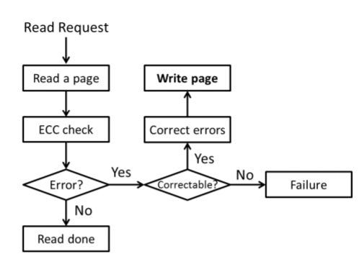
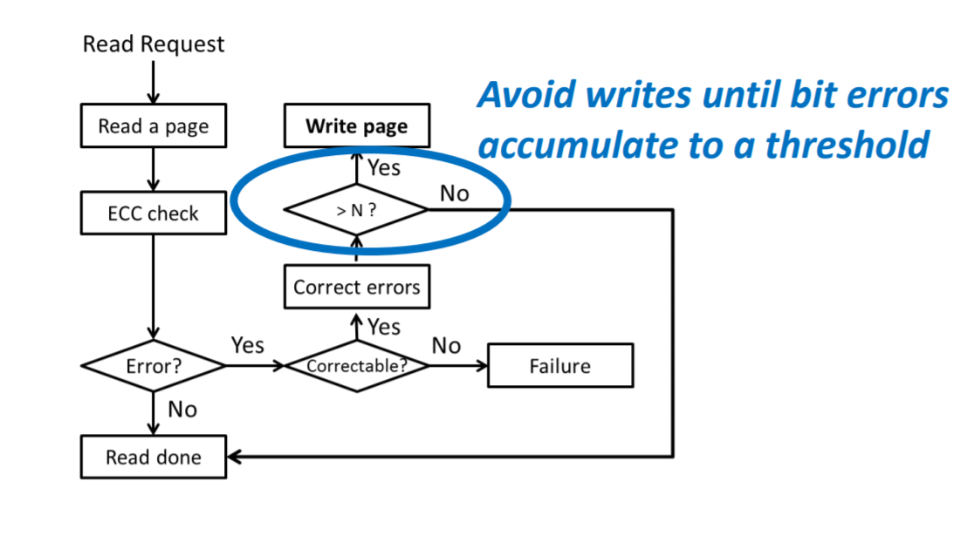
Today 공부한 내용
2. Write Amplification: ECC recovery
ECC: Error Correcting Code
W.A. due to ECC recovery
Reads lead to write
TECC 에 대한 간략한 스키마
(Write amplification due to ECC on flash memory or leave those bit errors alone, MSST’12 )

Slide 7
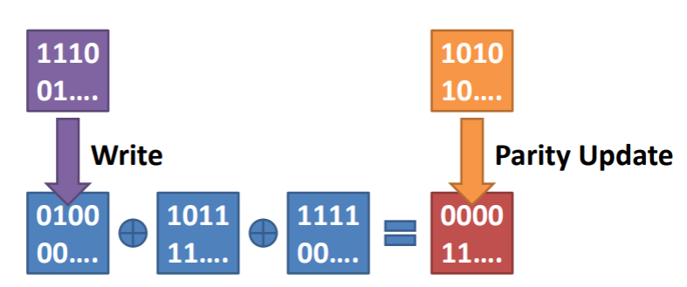
Today 공부한 내용
3. Write Amplification: Parity update(RAID5)
Parity Protection Scheme(RAID5)
정의: protect a device array from a device failure
1. Parity update results in additional writes
because parity block is the result from XOR operation of the data blocks
For a small write: W.A.F=2 -> 이유: the data block & the parity block is updated (WAF=2/1)
For a larger write: W.A.F=N/(N-1) -> 이유: N-1개의 data block이 update되면 parity block 1개도 update되기 때문
Data block이 update되면 parity block도 update되어야 한다.

Slide 8
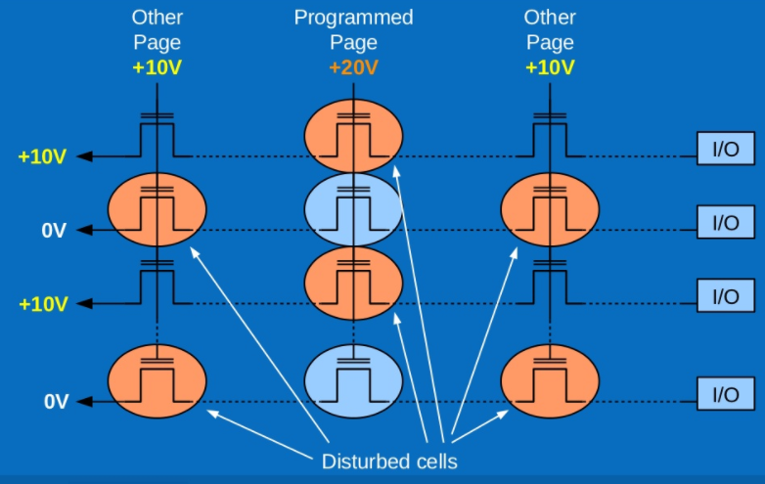
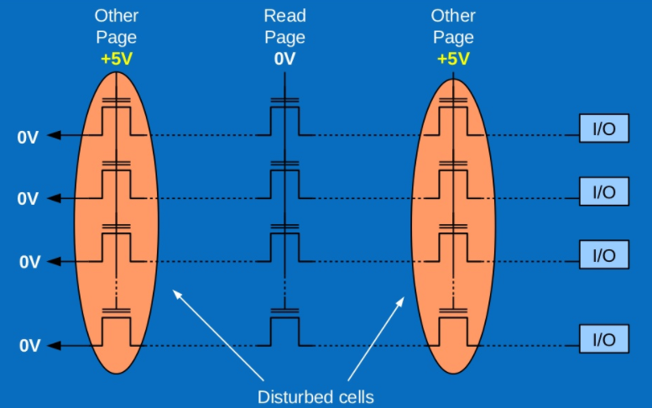
Today 공부한 내용
MLC bit error behavior of flash memory
Read disturb(per read): cells not being read receive elevated voltage stress
Data retention failure(per month): charge loss/gain occurs on the floating gate over time
Write error(per write): write disturb를 포함한 write error
(The Inconvenient truths for NAND Flash Memory , Flash Memory Summit’07)
Notes:
참고자료: https://cushychicken.github.io/assets/cooke_inconvenient_truths.pdf
https://www.slideshare.net/ennael/dwmw2-kr201209

Slide 9
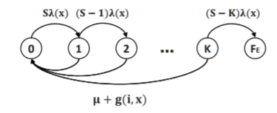
Today 공부한 내용
Markov model of page error rate
Markov model:은닉 마르코프 모델은 시간의 흐름에 따라 변화하는 시스템의 패턴을 인식하는 작업에 유용하다.
Markov model of page error rate
Probability(S1->S2)
S1
S2
Probability(S2->S1)
S: the number of bits in a page
K: the number of correctable bits by ECC per page
FE: (state) page error: ECC cannot recover the page(복구 불가능한 상태)
λ(x) : raw bit error rate
µ: page access rate (이거는 왜지? 무슨 page access ? ECC가 page에 access 하는 rate인가??)
g(i, x) : garbage collection access rate

Slide 10


Today 공부한 내용
Mean Time to Data Loss(MTTDL)
Mean Time to Data Loss(MTTDL):the mean time to data loss, the expected time to encounter the first data loss, 길면 길수록 Endurance 높다.
The data loss rate for single SSD
State(j)에서 data loss가 발생할 확률
State(1~j-1)까지 data loss가 발생하지 않을 확률
Time to write whole system once
Us : space utilization of SSD
T : the number of pages in an SSD
v(x) : uncorrectable page error rate

Slide 11



Today 공부한 내용
Mean Time to Data Loss(MTTDL)
The data loss rate for reaching state FR(data loss: RAID cannot recover the system )
Bit errors accumulate and result in a page error.
The entire device failure lead to the failure of all the pages in the device.
For N device striping
The rate of mirroring system fails (RAID2)
Assumption: each device pair is independent in a mirroring system
the pair fails with failure rate
For N devices in the mirroring system

Slide 12
Today 공부한 내용
V0에서 FR로 가는데 왜 N-1에 Page error rate 곱?
그림 새로 그리기 **
A Markov model of RAID5 system
The data loss rate for reaching state FR(data loss: RAID cannot recover the system )
Uncorrectable page error rate
(N-1)(v(x)+d)
NusTv(x)
Parity protection loses data when
Two Page errors in the same page group
Two device failures
Page error + device failure
Device failure + page error
v0
Data loss
FR
0
(N-1)(usTv(x)+d)
1
d0
Nd
n
Device failure rate
Device recovery rate

Slide 13
Today 공부한 내용
SSD Parameters(simulator에 대한 정보 X)
3x nm MLC flash memory (3x nm : 30 nm)
Capacity = 80GB (왜 capacity 80GB?? 그때 당시 SSD 성능 좋지 않을 때임을 고려할 것)
Page size=4KB
ECC: 61-bit errors correctable BCH code (왜 61bit, BCH)
Annual device failure rate=3% (참조 논문에 관련 내용 나옴 확인할 것)
TRIM command is exploited -> TRIM을 썼다
TRIM: OS가 어느 블록의 데이터가 더 이상 사용되지 않고 내부적으로 삭제될 수 있는지 SSD에 알려주는 명령어이다.
Simulation Parameters
The amount of data = 30GB/SSD (GC 영향 최소화?)
Workload
Read+Write = 125MB /s/SSD
Read:Write = 3:1 (왜?) 125/1(MB/s/SSD) : 125/3(MB/s/SSD) ????? -> 전체 WRITE 양 1GB
-> 현실 반영, 현실에서 read write 비율 어느정도? Workload
8 SSDs in an SSD array

Slide 14
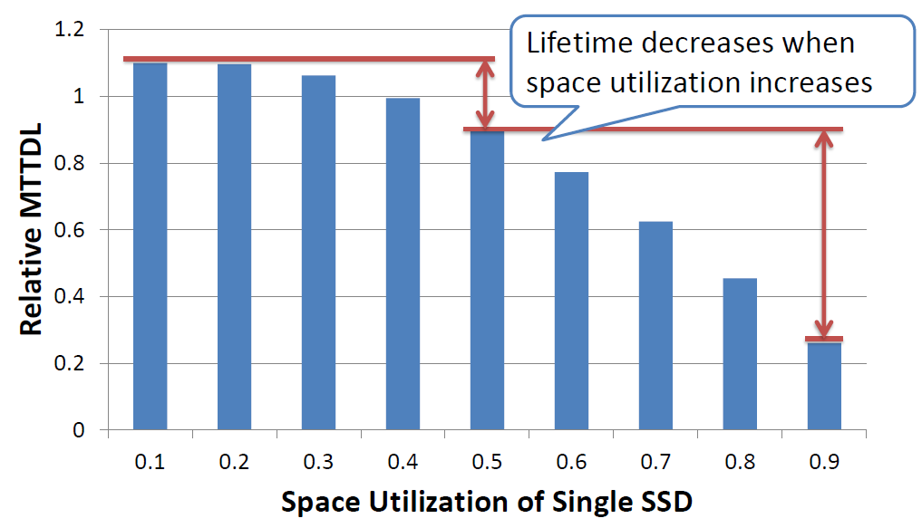
Today 공부한 내용
Relative MTTDL
The ratio of the lifetime of the target SSD array to that of single SSD with default parameters – 어떤 부분을 실험에서 변경하는지 뒤에서 확인
왜 0.5 기준으로 뒤로 갈수록 lifetime이 급격히 감소하는지?
-> GC overhead
70%감소
SSD의 space utilization을 어떻게 변경하지? 전체 쓴 data 양

Slide 15
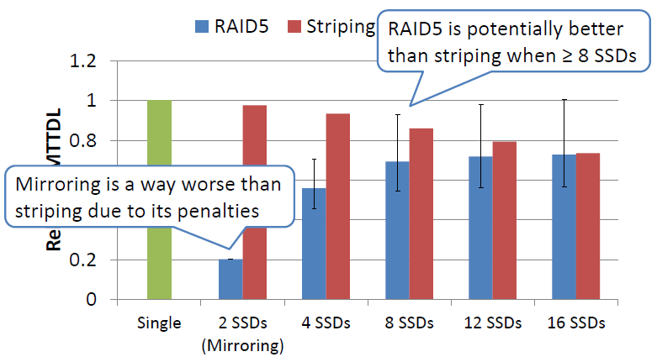
Today 공부한 내용
확인해야 할 것: parity write 어떻게 하는지,
Lifetime of different number of SSDs
최댓값
최솟값
왜 Mirroring? RAID5가 아니지 않나?
*The amount of data=30GB/SSD, The capacity of SSD = 80GB, The space utilization=37.5% ,
Over-provisioning=50GB

Slide 16
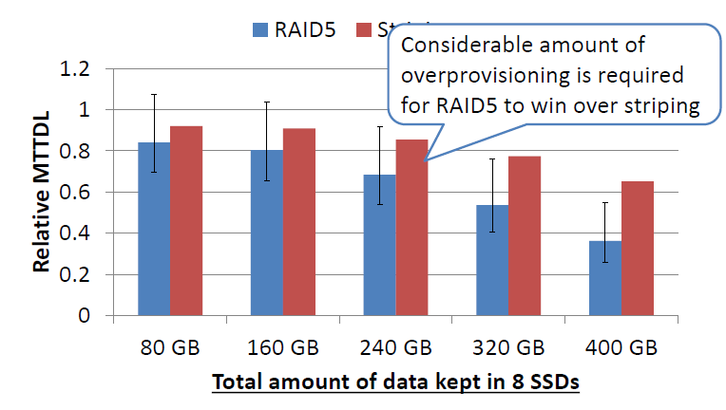
Today 공부한 내용
Different Amount of Data
결과값: 적어도 400GB 이상의 over-provisioning 공간 필요로 함
Over-provisioning=560GB
Over-provisioning=480GB
Over-provisioning=400GB
*8 SSD Capacity= 640GB
저장되어 있는 데이터의 양이 증가하면 할수록,
RAID5의 Endurance는 급격히 감소한다.
-> data의 양이 줄어들면, GC 와 Parity로 인한 overhead가 같이 감소
이유: 서로 independent하지 않기 때문

Slide 17
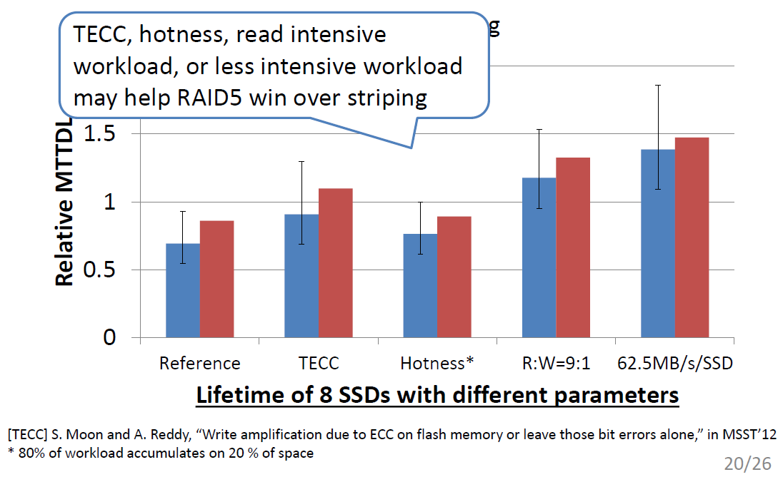
Today 공부한 내용
Different Parameters
*8 SSD Capacity= 640GB

Slide 18
Today 공부한 내용
Different Parameters
TECC(Threshold ECC)
ECC overhead 감소, parity overhead영향 증가
Hotness: slightly increase the W.A. (80% data in 20% of space)
GC efficient , GC overhead 감소
Slightly:
Read-intensive workload
Less write, but ECC로 인한 overhead가 62.5MB보다 크다
Less-intensive workload
More writes but lower read bandwidth, converts to redundant writes from frequent ECC recovery( read -> ECC로 error체크 -> write)
*8 SSD Capacity= 640GB

Slide 19
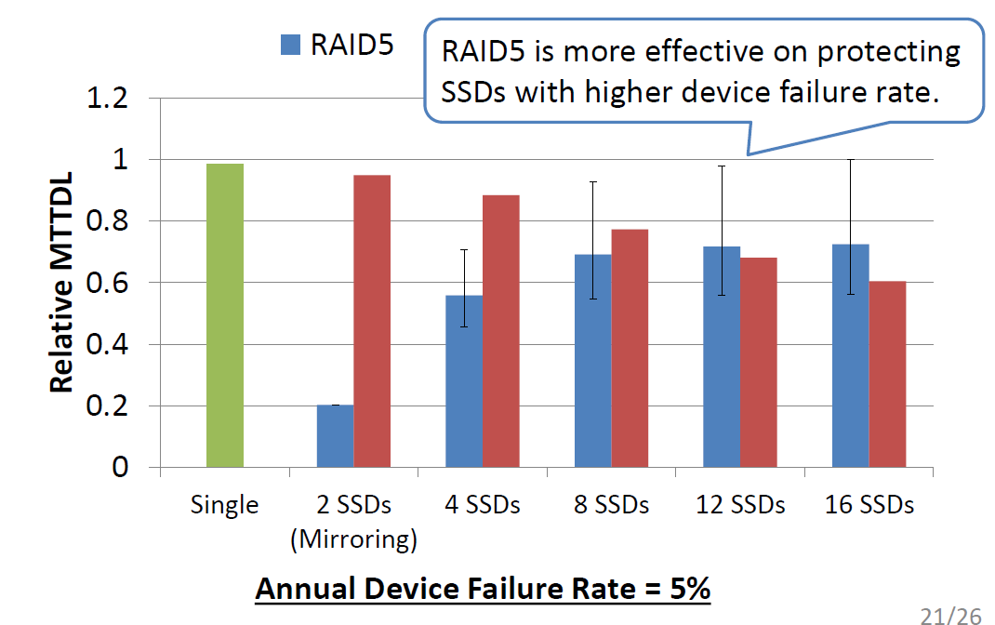
Today 공부한 내용
Device failure rate(annually 5%)
*8 SSD Capacity= 640GB
*8 SSD Capacity= 640GB

Slide 20
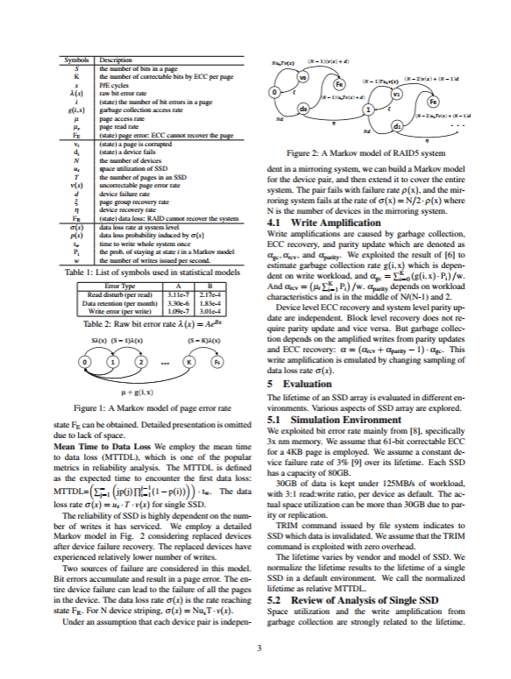
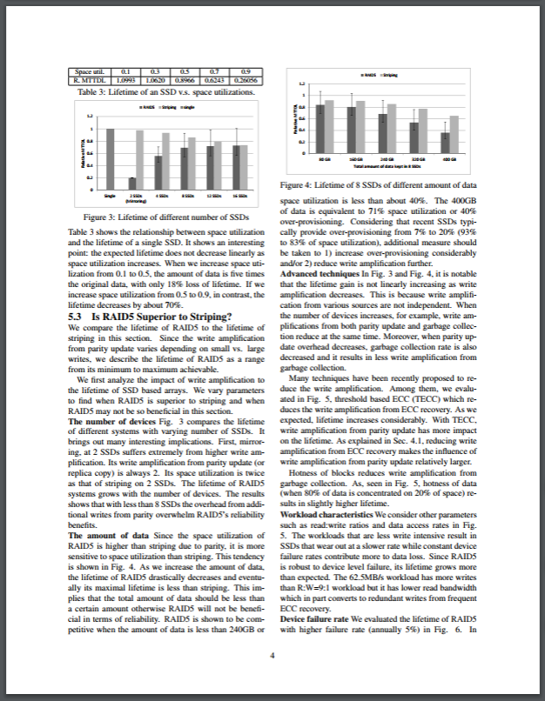
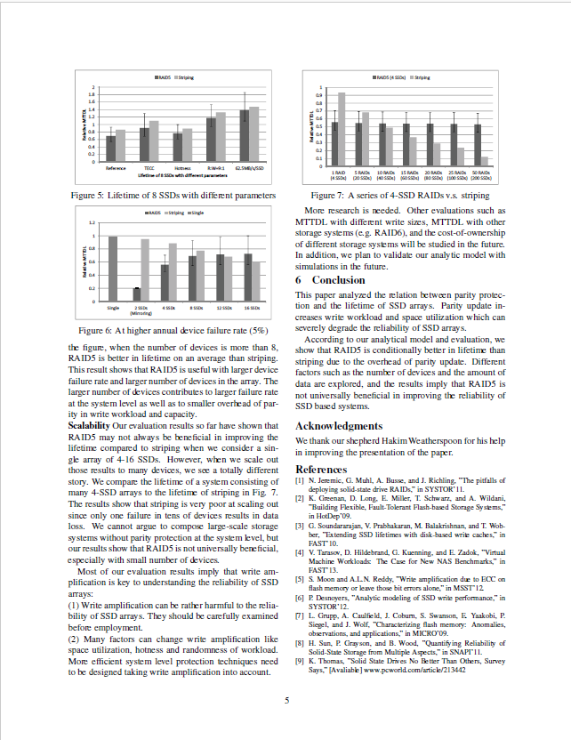
Today 공부한 내용
3p 4p 5p

Slide 21
Motivations
Locality Characterization
Value popularity: a characterization on frequency representing how many times an invalid page has been accessed before it is invalidated, number of times being read
The invalid pages with higher value popularity, more preferred by the host, are more likely to be recyclable invalid pages than those with lower value popularity.
*8 SSD Capacity= 640GB
*8 SSD Capacity= 640GB

